Slide 1
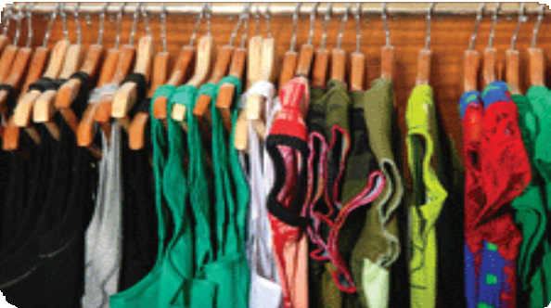
How to… host a swap party
Holding a swap party is a fantastic way of bringing new goodies into your life while at the same time cleaning out the old without costing you a thing!
What sort of goodies are we talking about?
You can swap clothes and shoes, tools, books, CD’s, DVD’s, toys, kitchen gear, or pots and pot plants. Basically, your can swap anything that isn’t tied down (sorry, kids, partners and in-laws exempt).
So how to do it?

Slide 2
Place and date
You’ll need to decide a date and location according to how big you want it to be: will your lounge room be big enough or will you need a backyard, shed or public hall?
Decide what to include
One fairly common type of swap party involves nothing but clothes, shoes, and accessories, often for women or men only. Other types of swap parties incorporate kitchen goods, small appliances, decorative items, linens, toys, and so on. If you’re into a particular hobby or craft, consider a meet at which you could exchange supplies and tools specific to your area of interest.

Slide 3
Invite the right people
Once you’ve settled on the type of swap party you’re going to hold, you can start to draw up your
guest list. Since the purpose of this party is to exchange things, you can afford to be a bit selective about who you invite: if you’re swapping clothes, think about only inviting a small group of people who share a similar taste in clothes (i.e. a lone Goth in a room full of hippies is going to be stretched to find someone to swap with). Or, if you’re aiming for a big crowd, invite a range of people so that the Goths AND the hippies AND the skaters get the chance to trade.

Slide 4
Set some ground rules
A bit dull, but very important: Before you send out invitations, draw up some ground rules. Think about what quality of stuff you’ll accept at the party (we suggest asking your guests to only bring things that are in good or great shape), or how to handle disagreements over items (you may need to step in), and what happens to things that don’t find takers by the end of the party (send the remainder to the op-shop or save for the next event). To make things simple you may want to pull numbers from a hat with each person getting to choose one item at a
time, or perhaps you’ll hold a free-for-all, or maybe you’ll decide that each guest will get to choose the same number of items as they contributed to the party.

Slide 5
Set up the space
Like any good party, you want to prepare. If you’re holding a clothes swap, you might want to set up some hangers and clothing racks or table space for folded things, and you might want to provide some space to act as a changing room for the modest guests. If you’re really organised ask people to bring bags or boxes with their names on them to cart their goodies away in.
Just as a general rule: try to clear anything of your own that you DON’T want to swap, or you may notice an unwelcome gap where that treasured vase from your grandmother once stood.
Good Luck!

Slide 6
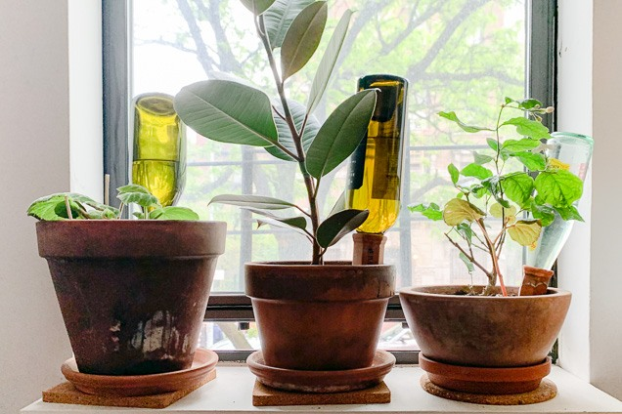
Mini green house
You need an old plastic bottle. Cut the bottle in half. Apply the cut bottle to the plants in the pot.
Plant watering system
You need a glass bottle make a small hole in the cork. Fill the bottle with water. Twist and put into the pot.

Slide 7
Tent lamp
You need a plastic bottle and a head torch.
Pour water into the bottle. Put a flashlight on the bottle

Slide 8
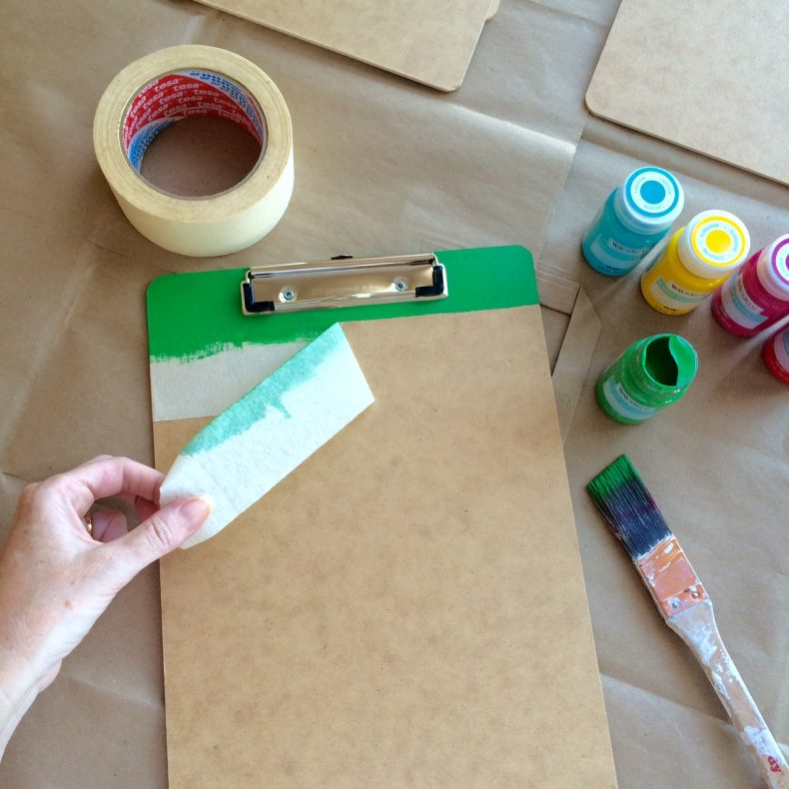
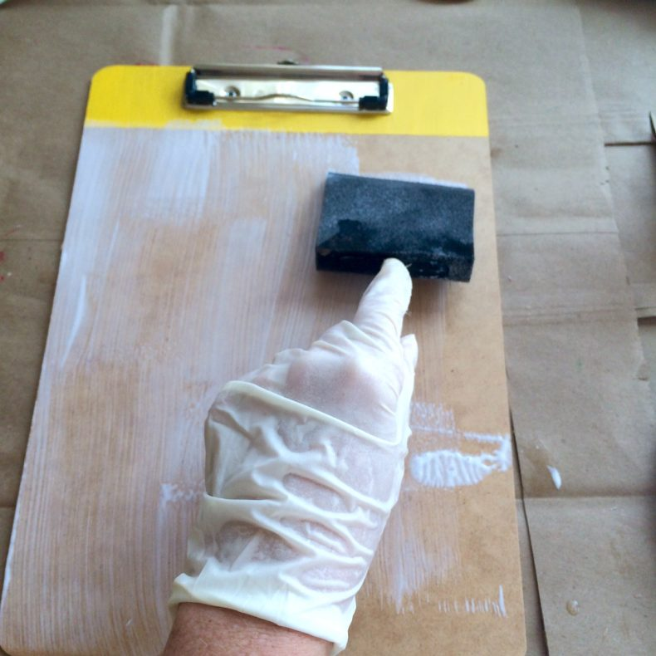
Mod Podge Clipboard
Supplies Needed:
6 clipboards
Painter’s tape or masking tape
Waverly Inspirations craft paint
Waverly Inspirations fabrics
Mod Podge, Matte
Paint brush
Scissors or rotary cutter
Step 1: Place tape underneath the clipping mechanism of your clipboard and paint the tops of your boards. Promptly remove the tape before the paint is dry. Painting the tops of your boards adds a fun design element and also makes this craft easier. Now you don’t have to worry about cutting the fabric around the clips!
Step 2: Cut your fabric to size. Using a disposable foam craft brush, paint on a layer of Mod Podge. I find it works best to cover both the board and the wrong-side of the material before positioning the fabric on the board.

Slide 9
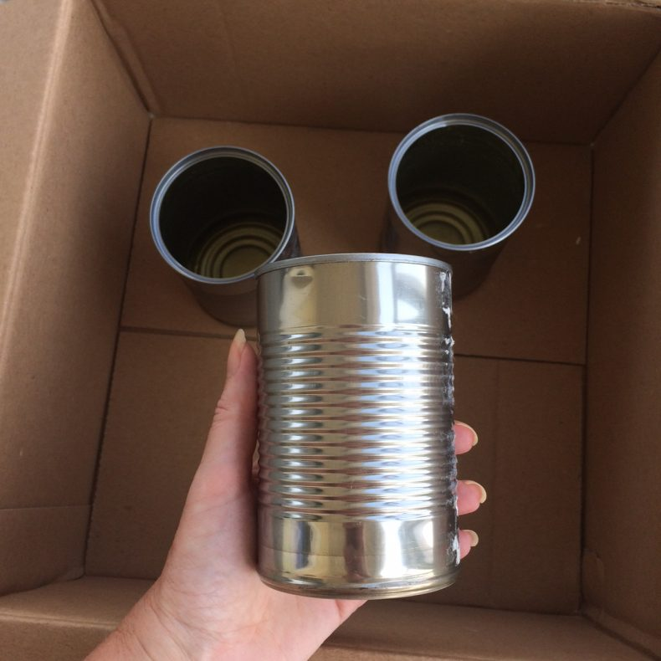
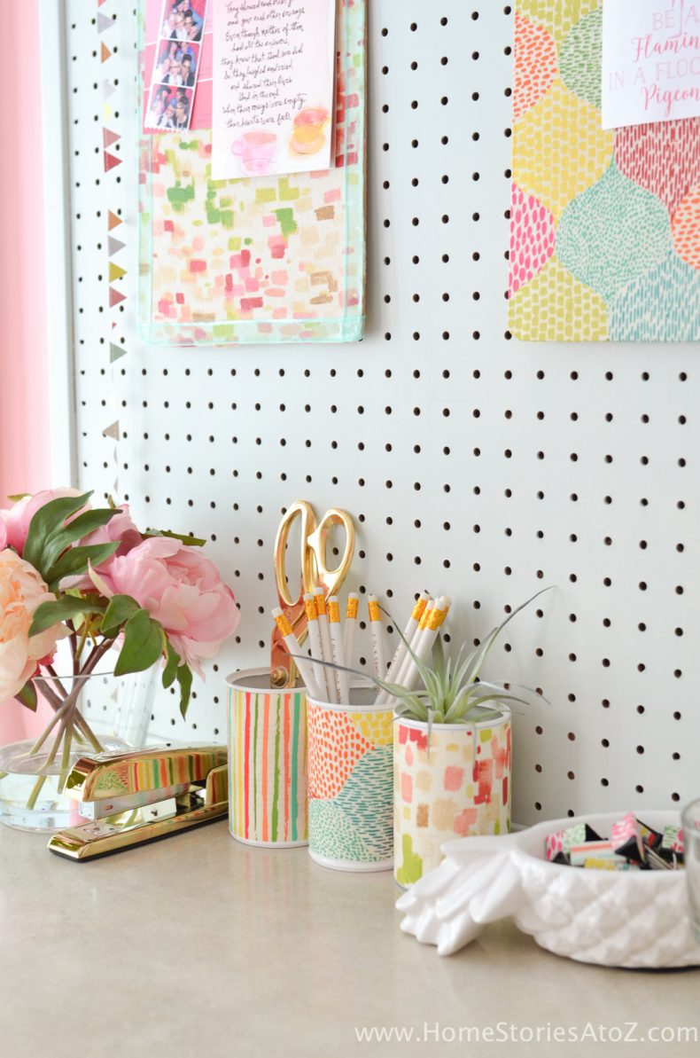
Mod Podge Tin Cans
Supplies Needed:
Clean and dry tin cans pulled from recycling.
RustOleum Paint + Primer Spray Paint
Waverly Inspirations fabrics
Mod Podge, Matte
Craft brush
1: Spray paint your clean and dry cans until completely covered. I find that two to three light coats with drying time in between works best Scissors or rotary cutterStep
2: Once the spray paint is dry, cut the fabric to size and cover the cans and the wrong-side of the fabric with Mod Podge. Allow to dry and fill with cute office supplies or a succulent!

