Slide 1
Ways to Be More Eco Friendly in Your Everyday Life
9

Slide 2
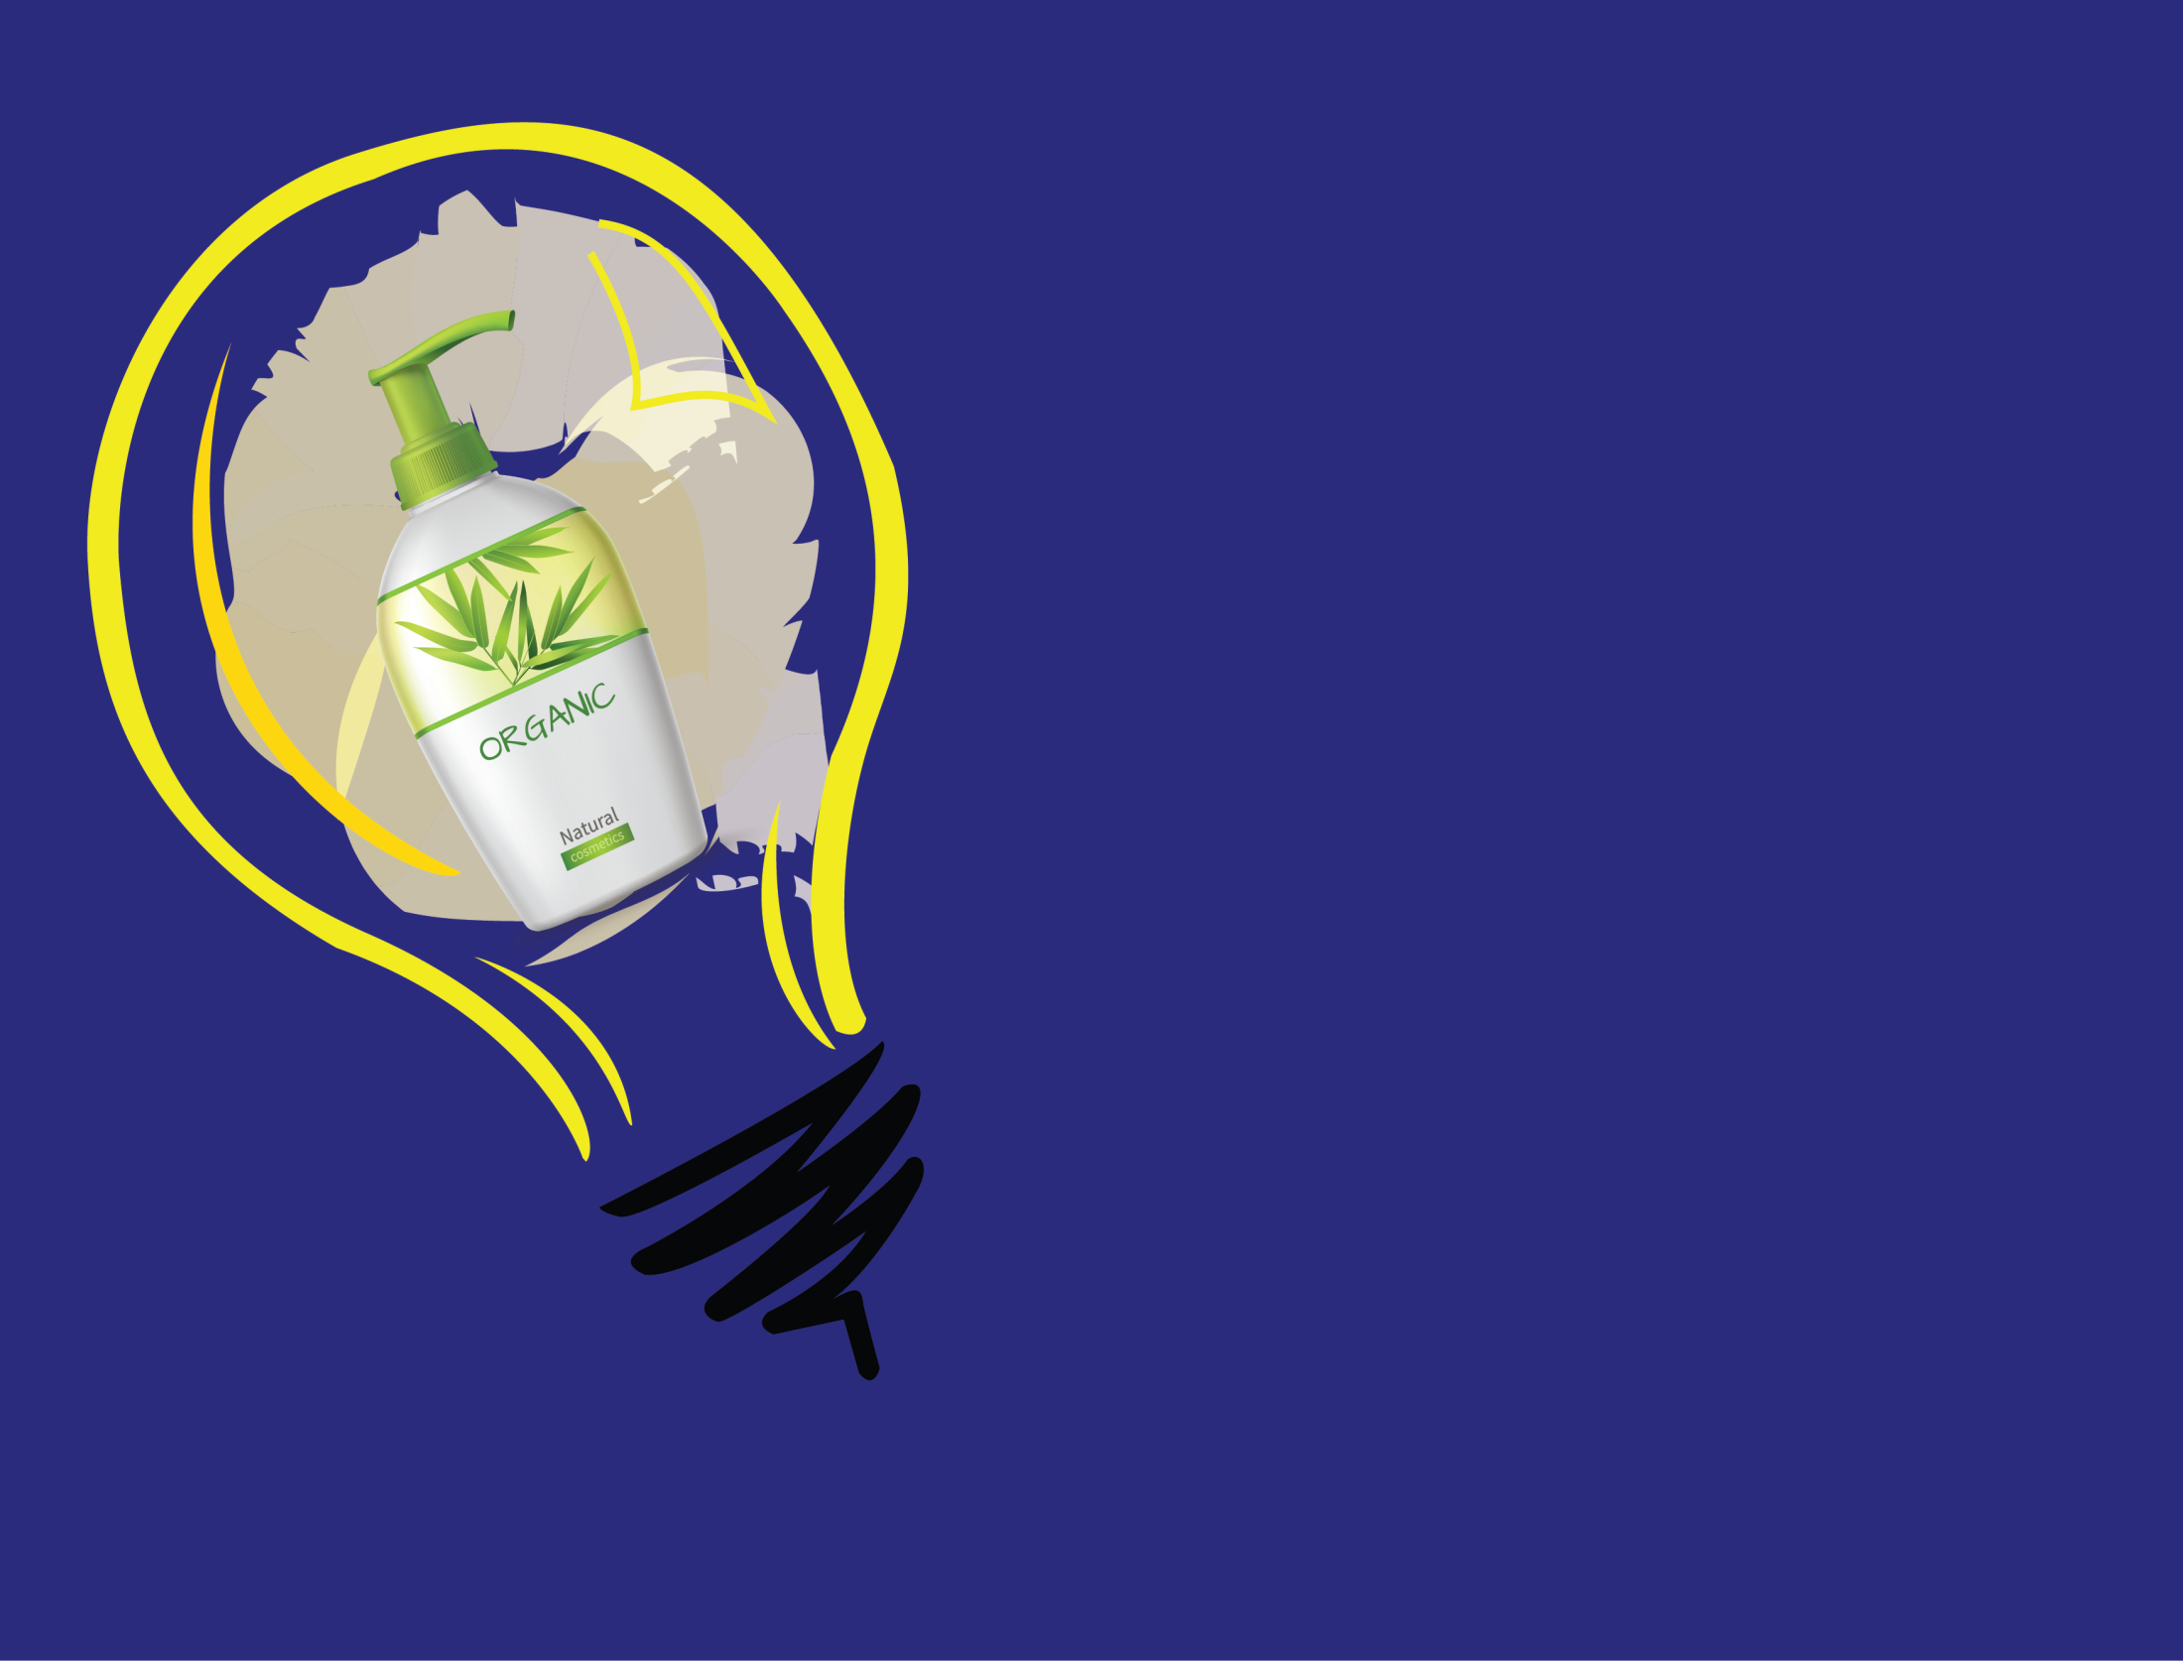
Use Environmentally Friendly Shampoo
Just like ingredients in cleaning products, regular shampoo, and conditioner also contain various ingredients that are washed down the drain and end up in the ocean again. The chemicals in those ingredients are often toxic in nature and should not be used. Wherever they end up, they may hurt the biodiversity.
Opt for non-synthetic ingredients when shopping for shampoo. As the shampoo bottles will ultimately be treated the same as other plastic objects, consumers can opt for soap bars that are suitable for hair. It's a great alternative, as these soap bars are often made from natural, biodegradable ingredients.

Slide 3
Use Recyclable Paper for Gifts
As a lot of trees go into the production of paper - whether it’s toilet paper, regular paper to write with, or wrapping paper, it’s important to be mindful and invest in recyclable paper. Back in 2017, there were approximately 419.69 million metric tonnes and cardboard being produced in the world. Based on this data, we are on a bad trajectoryin terms of paper and cardboard pollution if production does not halt.

Slide 4
Adopt Reusable Bag Practices
Take reusable bags to the store with you to grocery shop instead of opting for paper or plastic. It’s wasteful and unnecessary – and several bags with every grocery trip can add up to a whole lot of garbage over a lifetime

Slide 5
Buy Recyclable Clothes from Respectable Brands
The damaging effects that producing clothes has on the environment are pretty significant. Fast Fashion is mostly to blame, as clothes that fall into this category are produced in massive quantities. These quantities are produced only to be disposed off in billions, which can take up to 200 years to decompose for certain synthetic fibres (such as polyester).
. Consumers could be mindful of the type of clothes that they buy, which textiles they are made of, and look for companies that have promised to reduce their emissions and water pollution from producing garments.

Slide 6
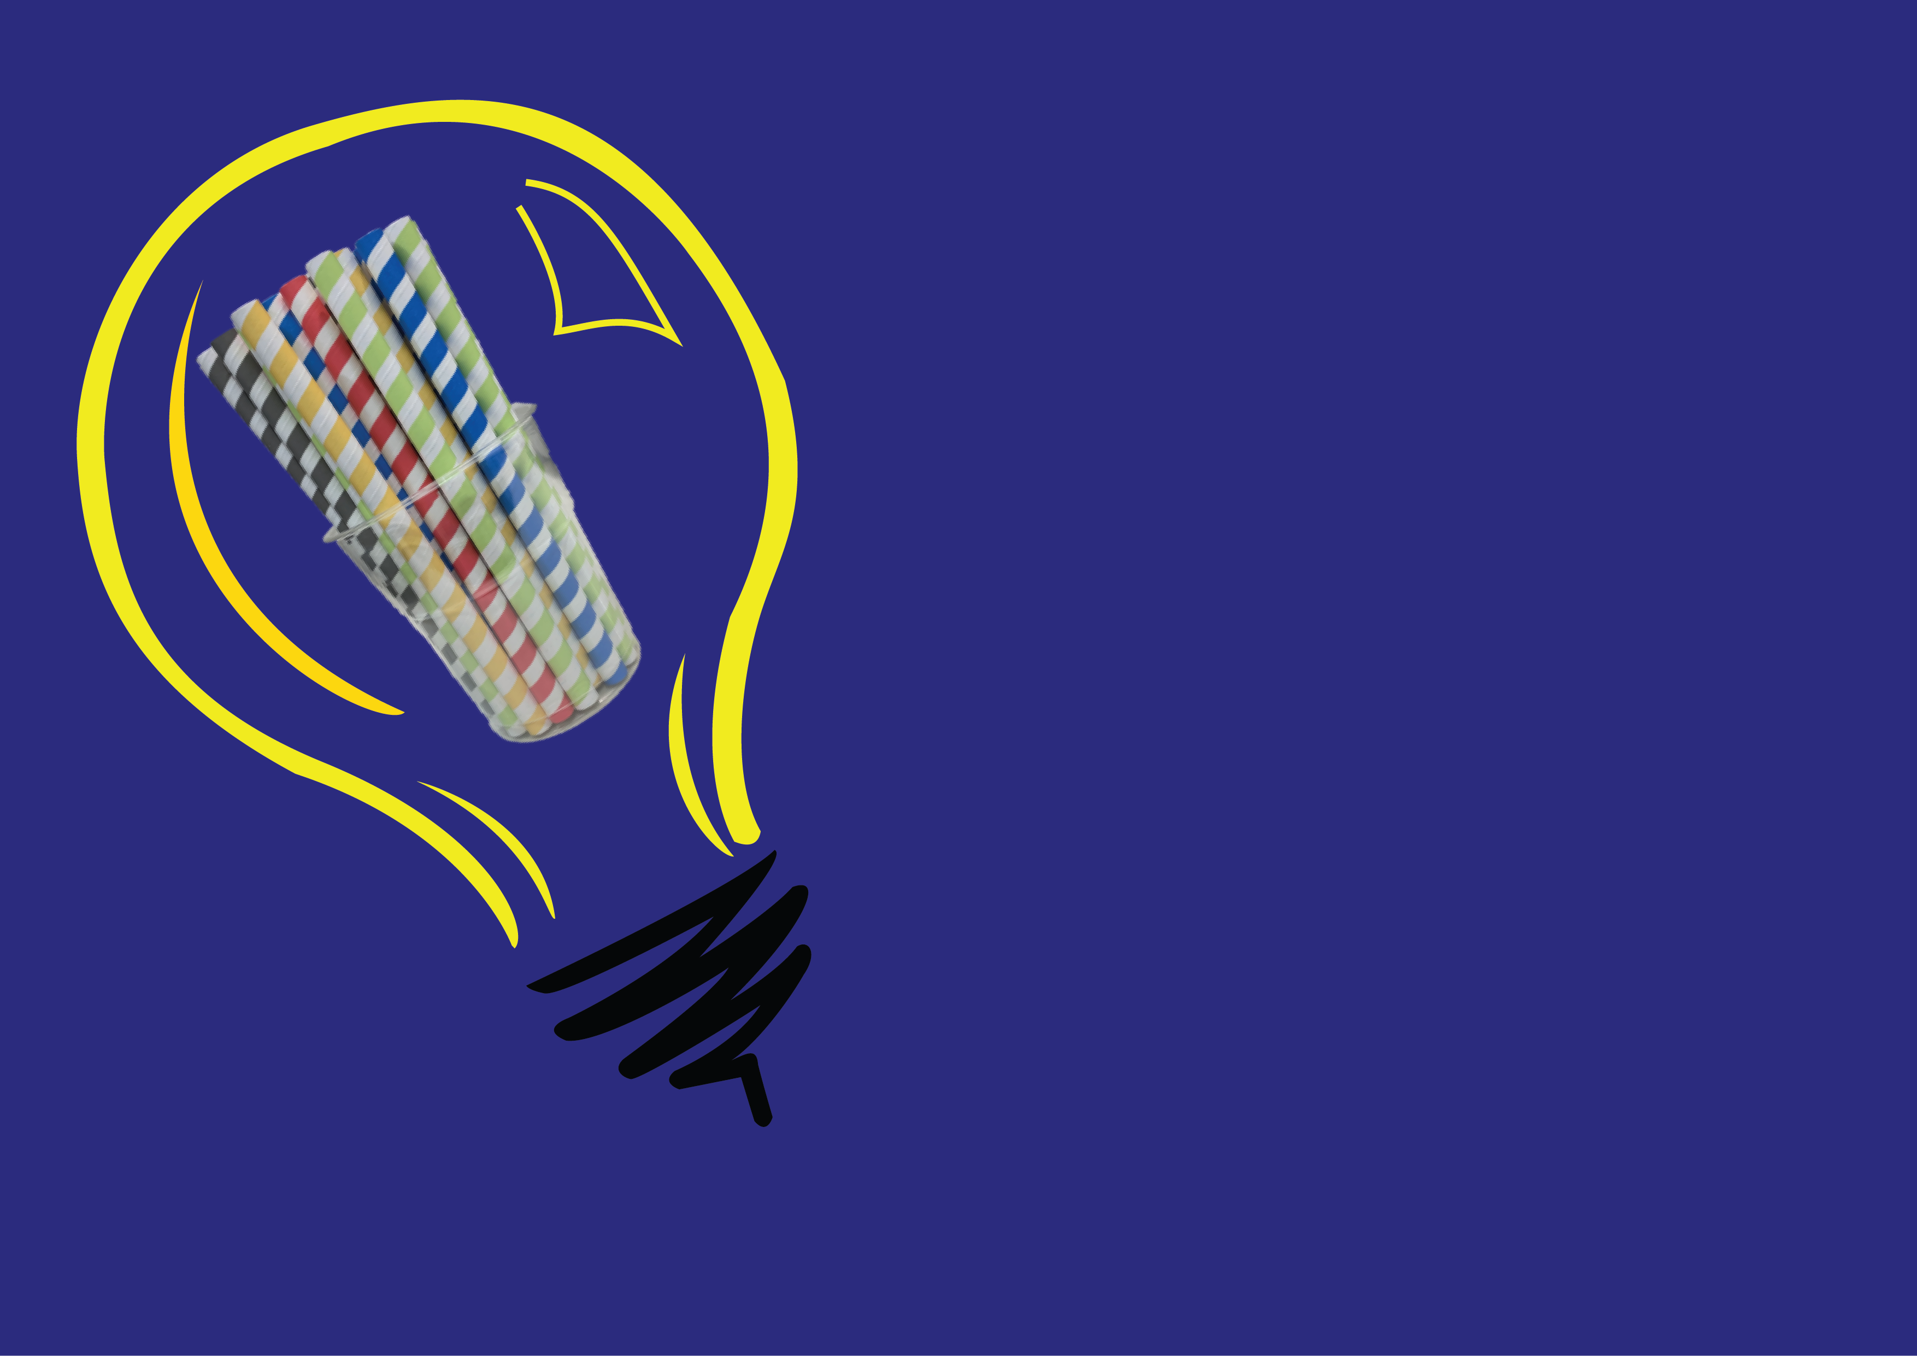
Stop Using Single-Use Plastic Straws
. As plastic waste is one of the biggest environmental challenges the world face, banning straws will make a huge difference..
Invest in a metal or bamboo straw that is reusable. It’s not only healthier for the environment, but it's also a cost-effective solution.

Slide 7
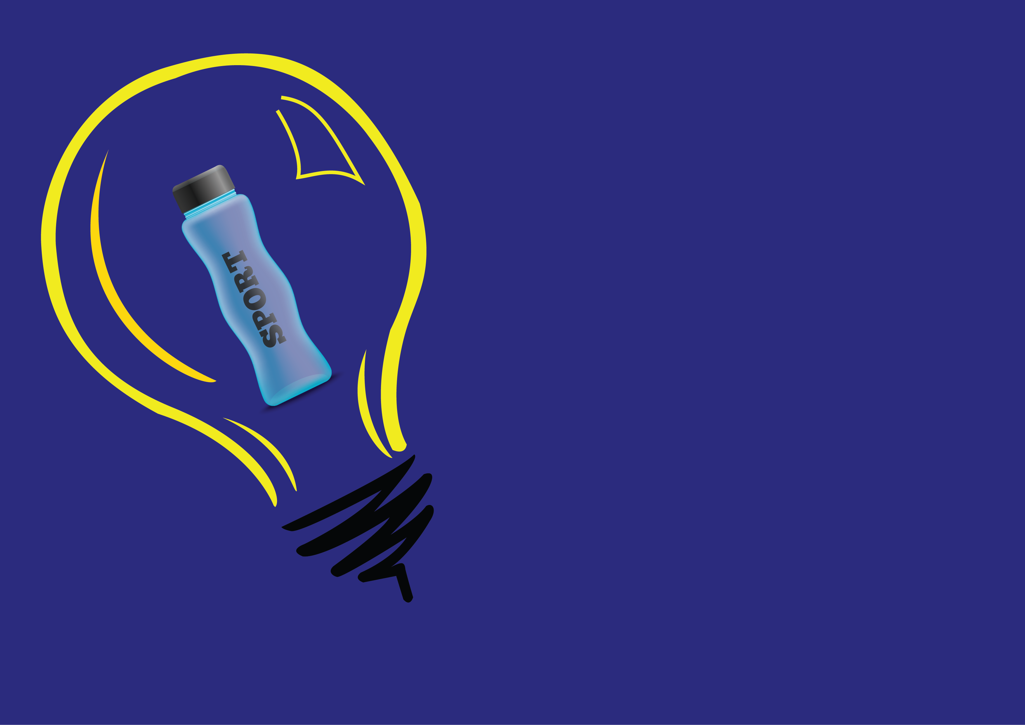
Use a Recyclable Eco Friendly Water Bottle
Purchasing water bottles is a common practice - particularly in warm weather. However, a lot of water bottles end up in the oceanas a lot of people fail to recycle them properly. This results in a high rate of pollution in our oceans and the overall environment, as one plastic bottle will break down into 10,000 microplastic pieces over time .
A solution to this problem is to invest in a water bottle that is not only reusable but also the right size, so you can take it with you whenever you travel.

Slide 8
Take Notes Electronically
Thankfully, the world is now digitally focused and your studies can be, too. You’ll save money (and stop wasting paper) on purchasing notebooks and flashcards if you begin to electronically take down what you need to remember in class.

Slide 9
Walk or Bike More
In addition to helping you live a healthier lifestyle, trying to cut down on driving can help the environment and save you a lot of gas money as well.

Slide 10
Think About Your Water Usage
Remember that old adage you’d repeat at the grade school drinking fountain, “save some for the fish?” You can do this in your daily life by turning off water while brushing your teeth, washing your face or shaving. In addition, cutting down your shower time can save more water and make a bigger impact than you’d think.

