Slide 1
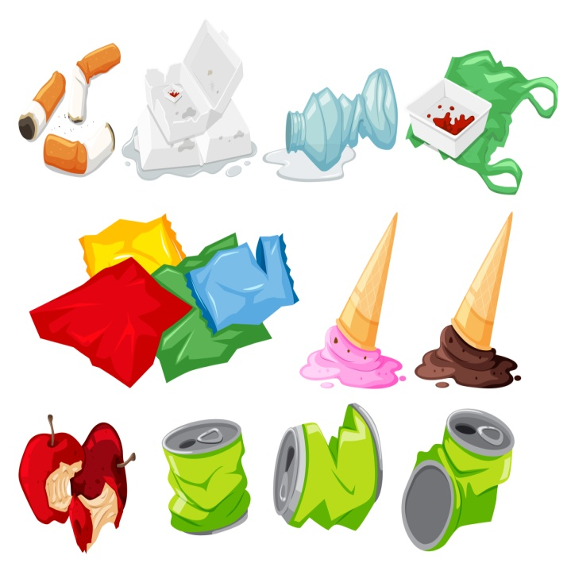

1
Instruction for nature tourists

Slide 2
Leave no trace when walking or camping

Slide 3
Leave no trace when walking or camping
Package your food in reusable containers and bags. This way you can reduce generating waste when hiking.

Slide 4
Leave no trace when walking or camping
Package your food in reusable containers and bags. This way you can reduce generating waste when hiking.
Walk in the wilderness with respect – do not make excessive noise or disturb animals.

Slide 5
Leave no trace when walking or camping
Make fire responsibly
Package your food in reusable containers and bags. This way you can reduce generating waste when hiking.
Walk in the wilderness with respect – do not make excessive noise or disturb animals.

Slide 6
Leave no trace when walking or camping
Make fire responsibly
Remember that making campfire and camping is allowed in specially prepared and designated places only.
Package your food in reusable containers and bags. This way you can reduce generating waste when hiking.
Walk in the wilderness with respect – do not make excessive noise or disturb animals.

Slide 7
Leave no trace when walking or camping
Make fire responsibly
Remember that making campfire and camping is allowed in specially prepared and designated places only.
Package your food in reusable containers and bags. This way you can reduce generating waste when hiking.
When making fire, prefer an outdoor fireplace (with chimney) and follow all instructions. In case the fire hazard index is five, i.e. the highest, it is advisable to avoid making fire.
Walk in the wilderness with respect – do not make excessive noise or disturb animals.

Slide 8
Use provided firewood or fallen branches for making fire. Also combustible organic waste can be burnt in the fire.

Slide 9
Use provided firewood or fallen branches for making fire. Also combustible organic waste can be burnt in the fire.
Clean up your trash

Slide 10
Use provided firewood or fallen branches for making fire. Also combustible organic waste can be burnt in the fire.
Clean up your trash
All that you can carry into the forest, you can also carry out. This way waste management will cause less impact on the environment, makes less noise and leaves less trace than using waste removal machinery.

Slide 11
Use provided firewood or fallen branches for making fire. Also combustible organic waste can be burnt in the fire.
If you do not take your trash away with you, put organic waste (tea bags, coffee grounds, food remains) in the nearest waste bin.
Clean up your trash
All that you can carry into the forest, you can also carry out. This way waste management will cause less impact on the environment, makes less noise and leaves less trace than using waste removal machinery.

Slide 12
Use provided firewood or fallen branches for making fire. Also combustible organic waste can be burnt in the fire.
If you do not take your trash away with you, put organic waste (tea bags, coffee grounds, food remains) in the nearest waste bin.
Clean up your trash
Burn combustible waste in the fire ring, but refrain from doing so in a period of fire hazard. Do not burn packages containing aluminium foil or plastic
All that you can carry into the forest, you can also carry out. This way waste management will cause less impact on the environment, makes less noise and leaves less trace than using waste removal machinery.

Slide 13
Wash yourself and the dishes on dry land

Slide 14
Wash yourself and the dishes on dry land
Collect used dishwater into a container and drain it into the ground after washing. This way water-bodies are not polluted

Slide 15
Wash yourself and the dishes on dry land
Collect used dishwater into a container and drain it into the ground after washing. This way water-bodies are not polluted
When washing yourself, do the same.

Slide 16
Wash yourself and the dishes on dry land
Consider carefully whether you need to use detergent/wash-up liquid.Usually water is enough
you need to use detergent/wash-up liquid. Usually, water is enough.
Collect used dishwater into a container and drain it into the ground after washing. This way water-bodies are not polluted
When washing yourself, do the same.

